Slide 1
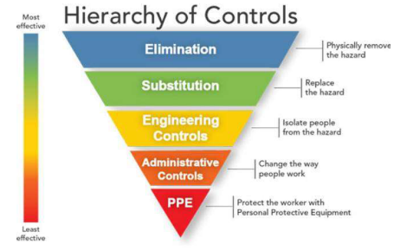
Wisconsin Paperboard Mill
Safety Best Practice
Burn Protection Improvement

Slide 2
Improving Burn Protection
Purpose
While the facility had previously implemented measures to drastically reduce burn risk in the dryer pits, there remained an elevated risk when PPE became wet with perspiration
Collected different products advertised as burn protection and recommended by various vendors.
Tested each product under simulated dry and wet conditions while at similar temperatures of the dryer cans.
Analyzed data and test results to determine best product under simulated conditions.
Collaborated with HexArmor® to develop product.
Completed trial in the facility and requested feedback from colleagues, which supported mass production.
Purchased & implemented improved PPE.
Process
Product
Can be laundered without compromising protective properties.
Grainger® is our distributor for purchasing the product.
Notes:
3P (Purpose, Process, Product) is a great tool to help organize your thoughts on meetings, people engagements, training, and workshops. The following highlights a few tips when developing a 3P:
Start with the ‘Products’ First – What do you want to accomplish from the meeting, training, workshop, interaction. It is important to define what you expect to get out of the interaction at the end
Next comes the ‘Process’ – What and how do you want to process the engagement/meeting/interaction to insure that you get the ‘Products’ defined in the section. You want to not only think about the outline and flow of the process, but think about how you can keep it fun, engaging, and interactive. The final check with how well you set up the process…..Will I achieve the ‘Products’ if we follow this ‘Process’.
Last item is the ‘Purpose’ – Looking at the products and process, define the overall purpose of the interaction. It is the justification for why we are getting together.

Slide 3
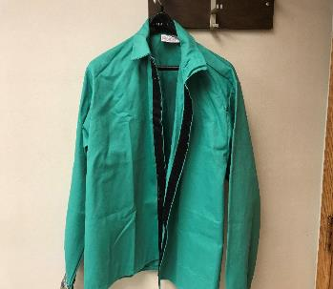
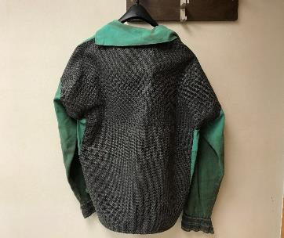
Testing Subjects
Original burn jacket used.
100% cotton.
Tillman: Part Number for jackets – 6230 VCF (series)
Original burn jacket modified with SuperFabric® pieces by HexArmor®

Slide 4
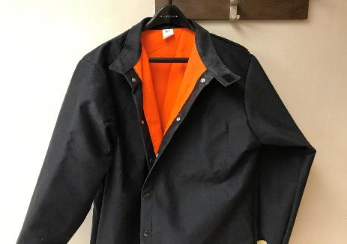
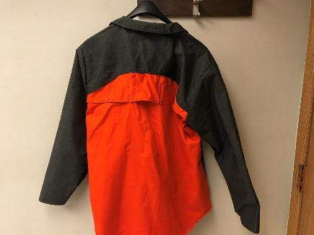
Testing Subjects
Sample #1
Sample #2
Two sample jackets were received from Chicago Protective Apparel, both of which were made of a combination of synthetic fibers and cotton (supplied & recommended by Grainger ®).

Slide 5
Testing Results
Procedure
An electric hot plate was used to heat a 5” x 5” steel plate to 330 °F. Temperature was measured with an infrared digital laser thermometer. The outside of each burn jacket was then pressed against the heated plate and the temperature of the inside of the jacket was measured for 5 seconds. The initial and final temperatures were recorded. The inside of the burn jacket was then soaked with water and the process was repeated for each jacket.
Results
The table below shows the change in temperature that was recorded through each of the jackets after 5 seconds. The HexArmor ® coated jacket proved to be the best in the application with the temperature of the opposite side of the fabric only increasing 4 °F/s. It also proved to be the best when soaked with water showing little change as to when dry.
 | Original Burn Jacket (New) |  | Original Jacket With HexArmor® |  | Chicago Protective Apparel Sample #1 |  | Chicago Protective Apparel Sample #2
 | Dry | Wet | Dry | Wet | Dry | Wet | Dry | Wet
T_{i} (°F) | 90 | 70 | 90 | 70 | 90 | 70 | 90 | 70
T_{f} (°F) | 150 | 172 | 110 | 88 | 150 | 112 | 208 | 163
ΔT (°F) | 60 | 102 | 20 | 18 | 60 | 42 | 118 | 93
(°F/s) | 12 | 20.4 | 4 | 3.6 | 12 | 8.4 | 23.6 | 18.6

Slide 6
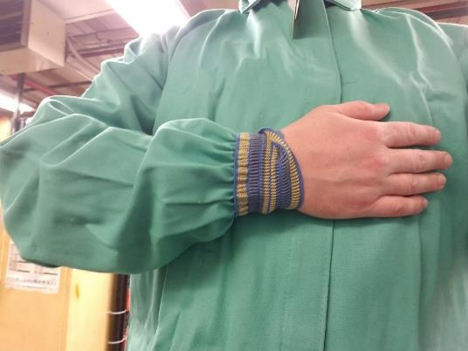
Additional Risk Reduction Measures
Cuff added to burn jacket to prevent sleeve from catching dryer head bolts during hand tailing of the machine.

